Slide 1
BHARATI VIDYAPEETH (Deemed to be University) SCHOOL OF ALLIED HEALTH SCIENCES
SKILL DEVELOPMENT COURSES
Academic Year
2024-2025

Slide 2
Introduction
The training programme for capacity building
‘State Of Art’ infrastructure
Experienced and dedicated faculty.
Attached to a spacious well equipped tertiary care hospital and excellent clinical exposure.
Will increase the employability in various hospitals, private clinics, medical centers, doctors office.

Slide 3
Courses Offered
MSc and BSc Degree Courses
Post Graduate Diploma Courses
Certificate Courses

Slide 4
BSc Paramedical Technology (Radiographic Technician)

Slide 5
X-ray
Ultrasonography
Computed Tomography (CT),
MRI (Magnetic Resonance Imaging)
PET Scan.

Slide 6
What do we learn?
Basic Sciences including Anatomy functions and surface landmarks of various organs and systems.
Introduction to basic imaging including CT and Ultrasound
Knowledge of working of MRI machine including care of the patients undergoing MRI.
Administration and Radiation safety in Interventional procedures

Slide 7
Major Areas of Training
Perform all routine x-rays – mobile and steady, medico legal x-rays, poly-trauma X-rays.
Assist all conventional procedures like IVP, IU, MCU, Barium procedures, HSG, etc.
Perform all plain CT scan of whole body.
Assist in CECT, CT angio and CT guided procedures.
Perform all plain MRI scans.
Assist in contrast enhanced MRIs, specialised MR sequences.

Slide 8
Major Areas of Training
Assist in ultrasonography, in record keeping and patient preparation.*
Perform CPR in case of emergencies in department.
Describe the radiation hazards, radiation safety issues and relevant administrative issues

Slide 9
Certification
“BSc Radiology & Imaging Technology”
Employment
Hospitals
Imaging Centres
Private Clinics
Government jobs

Slide 10
BSc Paramedical Technology (Endoscopic Technician)

Slide 11
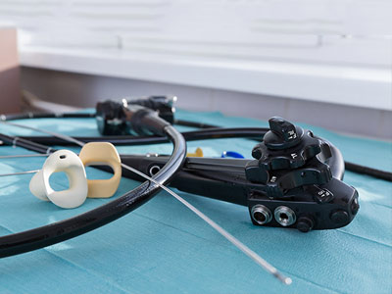
Endoscopy technicians assist physicians and nurses with endoscopy procedures and other minimally invasive procedures.
Endoscopy involves looking inside the body for medical reasons by use of an endoscope.

Slide 12
What do we learn?
Basic Sciences including Anatomy and functions of cardiovascular systems.
Aspects of OT, Endoscopy room, aseptic techniques, sterilization, basic maintenance, cleaning and storage of equipment, preparation of trolley in OT for Endoscopy, Monitor the patient etc.

Slide 13
Uses of Cardiovascular Technology
An endoscopy uses a scope that goes inside your body to take pictures or videos of organs and other structures. Healthcare providers use them to screen, diagnose and treat conditions. There are many types of endoscopy that view different organs.
Endoscopy may be used to investigate symptoms in the digestive system including nausea, vomiting, abdominal pain, difficulty swallowing, and gastrointestinal bleeding. It is also used in diagnosis, most commonly by performing a biopsy to check for conditions such as anemia, bleeding, inflammation, and cancers of the digestive system. The procedure may also be used for treatment such as cauterization of a bleeding vessel, widening a narrow esophagus, clipping off a polyp or removing a foreign object

Slide 14
Certification
“BSc Paramedical Technology
(Endoscopy Technician)”
Employment
Hospitals
Private Clinics
Government jobs

Slide 15
BSc Paramedical Technology (Cardiology Technician)

Slide 16
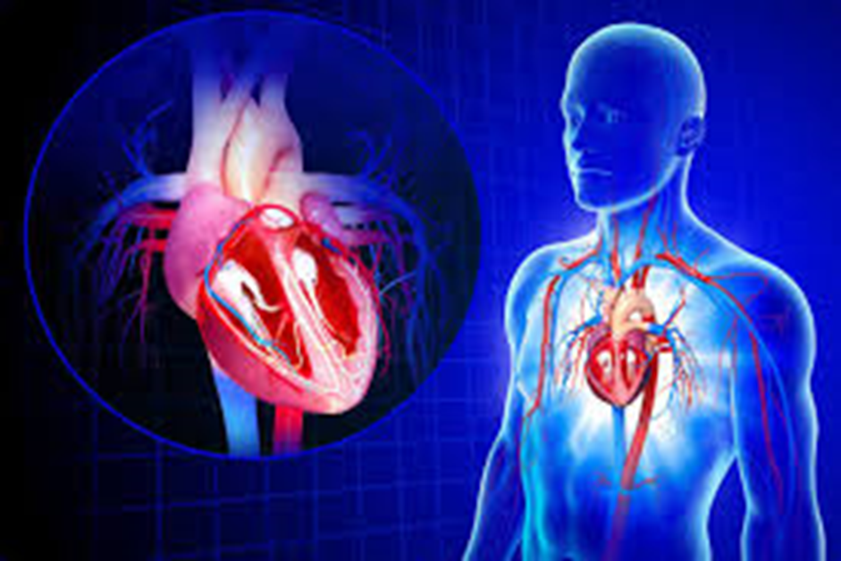
Cardiac Technologists assist physicians in: diagnosing and treating cardiac (heart) and peripheral vascular (blood vessel) conditions. ...
Management of various cardiac disorders having complex diagnostic and therapeutic procedures

Slide 17
What do we learn?
Basic Sciences including Anatomy and functions of cardiovascular systems.
Clinical aspects of cardiac diseases and the need and rationale for cardiac related therapies.
Introduction to assisted Ventilation and cardiac management in various conditions and ages.

Slide 18
Uses of Cardiovascular Technology
A cardiovascular technologist use medical imaging methods like ultrasounds to diagnose heart conditions, vascular problems, or ailments that involves the heart, it's arteries, valves, or blood vessels.
Cardiovascular technologists and cardiovascular technicians serve as cardiovascular assistants to physicians.
They aid in the diagnosis and treatment of heart and blood vessel issues. Their day-to-day tasks include reviewing doctor and patient documentation, scheduling appointments and monitoring patients' heart rates.

Slide 19
Major Areas of Training
Assessment of cardiovascular system
Symptomatology and signs of cardiac diseases
Rationale for Oxygen therapy
Assessment of need and adequacy and therapy and the relevant devices
Gas analyzers
Advanced cardiac care including neonatal ventilation

Slide 20
Certification
“BSc Paramedical Technology (Cardiology Technician)”
Employment
Hospitals
Cardiac Cath Labs
Private Clinics
Government jobs

Slide 21
BSc Paramedical Technology (Neurology Technician)

Slide 22
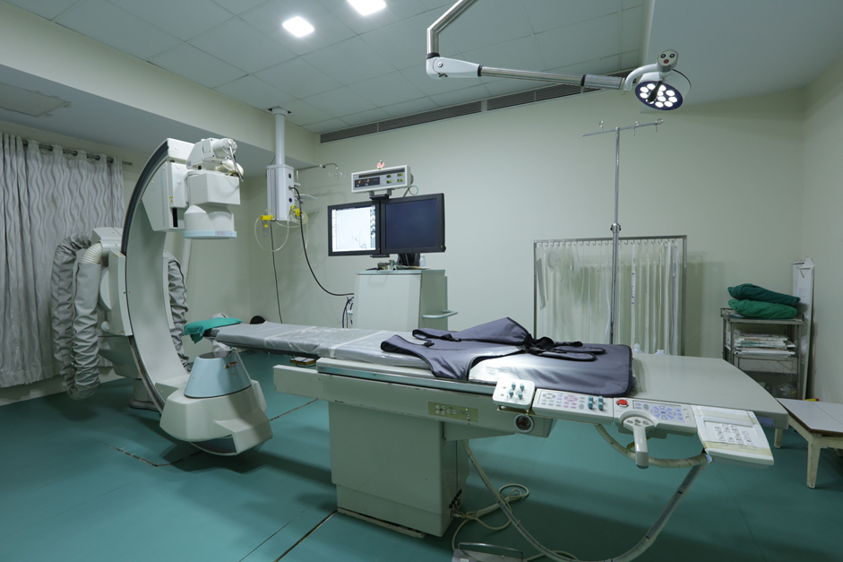
Neuro Electrophysiology course enables the neuro technologists to perform and interpret electrophysiology procedures.
It enables students to assess the patient and plan various electro-diagnostic procedures and implement them. ...
The student will be able to achieve technical skills needed to conduct various diagnostic procedures

Slide 23
What do we learn?
Basic Sciences including Anatomy and functions of Nervous systems.
Clinical aspects of nervous system related diseases and the need and rationale for nervous system related therapies.
Introduction to management in various conditions related to nervous system.

Slide 24
Major Areas of Training
Sleep studies
Autonomic function tests
Pre-surgical evaluation of epilepsy
EEG (including Neonatal and long term monitoring)
Nerve conduction studies, Electromyogram, Visual evoked potential, Brainstem auditory evoked potential, Somatosensory evoked potential

Slide 25
Certification
“BSc Paramedical Technology
(Neurology Technician)”
Employment
Hospitals
Neural Labs
Private Clinics
Government jobs

Slide 26
BSc Paramedical Technology (Operation Theatre Technician)

Slide 27
They are responsible for direct and indirect patient care, equipment set up and operation procedures.
They are trained to assist the surgeons during the procedures and assume responsibility for completion of other functions as assigned.
Learn about anesthesia equipment, anesthesia agents, techniques as well as dosage in order to ensure a better monitoring of the patient.
The knowledge gained by the students through B.Sc. in Anesthesia Technology helps them in choosing the right anesthetic treatment for a patient and its dosage.

Slide 28
What do we learn:
Prepare and maintain operation theatre Maintain equipment support in an emergency situation.
Follow infection control policies and procedures Maintenance of theatre equipment's
Provide intra-operative equipment and technical support
Manage hazardous waste
Ensure availability of medical and diagnostic supplies
Maintain a safe, healthy, and secure working
Follow radiation safety guidelines
Follow biomedical waste disposal protocols
Record keeping

Slide 29
Uses of Anesthesia & Operation Theatre Technology
Anesthesia and OT technology is a job oriented course and their main task is to assist Doctors/Surgeons during surgery, by administering appropriate dose of anesthesia and operating anesthesia equipment whenever required.
The Operation Theater and Anesthesia Technologist are responsible for direct and indirect patient care, equipment set up and operation procedures. They are trained to assist the surgeons during the procedures and assume responsibility for completion of other functions as assigned.
A modern Operation Theatre is a cornucopia of various state of the art machines & equipment's. The set up, preparation and handling of these equipment then becomes a vital part of the functioning. ... Operation theatre technology is meant to train the candidate in all the procedures in operation theatre.

Slide 30
Major Areas of Training
IV fluids and Transfusion related matters
Dressing, sutures, bandages and plasters
Recovery room and nursing care
Pre-Operative and Post-Operative
Management of Patients
Patient handling and Transportation to and from the Operation theatre
Universal precautions for HIV Positives, HBsAg Positive
Introduction to Operating room
Discipline, Lay out, Equipment’s, Lights,
OT table, suction, scrub station
Electrical Devices – Electro cattery, Laser, Harmonic, Ligature
Power Surgical Instruments – Drills Saw, Reamer
Sterilization assembly and packing
Principles of Sterile Techniques – Surgical scrub, gowning and gloving
Surgical instrumentation, handling instruments

Slide 31
Certification
“BSc Paramedical Technology (Operation Theatre Technician)”
Employment
Hospitals
Cardiac Cath Labs
Super speciality Hospitals
Private Clinics
Government jobs

Slide 32
BSc Paramedical Technology (PerfusionTechnician)

Slide 33
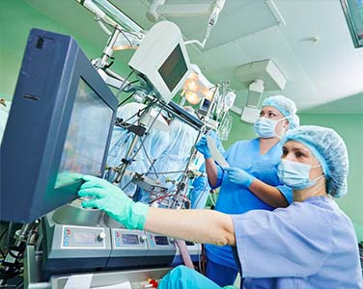
Cardiovascular perfusion is the science of providing extracorporeal circulation in order to artificially support and temporarily replace a patient’s respiratory and circulatory systems.
A perfusionist is a skilled allied health professional, trained and educated specifically as a member of an open-heart surgical team, responsible for the selection, setup and operation of a Heart-Lung Machine and other life support system like IABP, LVAD, RVAD & ECMO.
It will help in overall development of technical and interpersonal skills required to work under the supervision of Cardiologists, CTVS surgeons and Anaesthetists.

Slide 34
Scope
Perfusion technology has a wide range of applications since it is an essential job function that cannot be easily replaced. A perfusionist is required by every surgical team to control the technical elements of the medical equipment so that the physicians and nurses may concentrate on their duties.
After finishing a B.Sc. in perfusion technology, students might pursue further studies in the field. Candidates with a master’s degree and speciality will have a greater chance of landing a job and will have an advantage over the competition. These perfusionists and technicians are in charge of the surgery’s heart and lungs apparatus and equipment.
You can also pursue an MSc in Cardiac Perfusion Technology, which can open up numerous doors for you in the future.
These technicians and perfusionists run the surgical machinery for the heart and lungs. Additionally, they control blood vessel conditions.

Slide 35
Certification
“BSc Paramedical Technology (Perfusion Technician)”
Employment
Hospitals
Super speciality Hospitals
Private Clinics
Companies
Government jobs

Slide 36
BSc
(Respiratory Therapy)

Slide 37
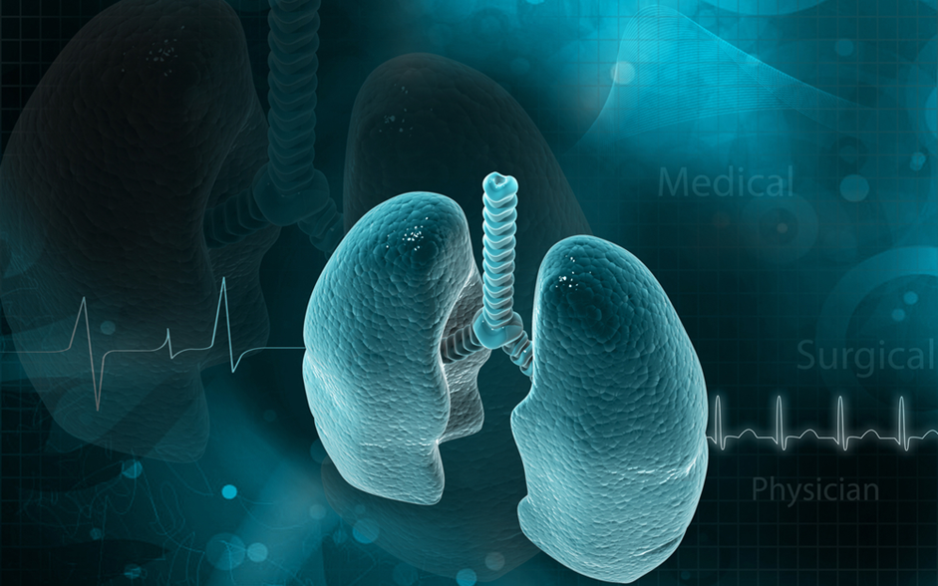
BSc (Respiratory Therapy)
Respiratory Therapy is devoted to the scientific application of technology in order to assist in the diagnosis, treatment, management and care of patients with cardiopulmonary and associated diseases.
To be precise, it deals with cardiopulmonary problems. The respiratory system is prone to diseases and conditions such as – trauma, bronchitis, asthma, pneumonia etc

Slide 38
What do we learn?
Basic Sciences including Anatomy and functions of respiratory and cardiovascular systems.
Clinical aspects of respiratory diseases and the need and rationale for Oxygen therapy.
Introduction to assisted Ventilation and Airway management in various conditions and ages.

Slide 39
Uses of Respiratory Care Technology (Respiratory Therapy)
Respiratory therapists help people who suffer from chronic respiratory diseases like asthma, bronchitis and emphysema. ... They also provide emergency care to patients suffering from heart attacks, drowning or shock.
This would involve managing patients on ventilators and artificial airway devices, and assessing the blood-oxygen level of patients. Just a few of the responsibilities of respiratory therapists include: Managing life support mechanical ventilation systems. Administering aerosol-based medications.

Slide 40
Major Areas of Training
Assessment of respiratory and cardiovascular system
Symptomatology and signs of Respiratory diseases
Rationale for Oxygen therapy
Assessment of need and adequacy and therapy and the relevant devices
Nebulizers and metered dose inhalers
Gas analyzers
Manual resuscitators
Artificial airway
Mechanical ventilation principles and pharmacotherapy
Advanced Respiratory care including neonatal ventilation

Slide 41
Certification
“BSc”
(Respiratory Therapy)
Employment
Hospitals
Imaging Centres
Private Clinics
Government jobs

Slide 42
Thank You

