Slide 1
BHARATI VIDYAPEETH (Deemed to be University) SCHOOL OF ALLIED HEALTH SCIENCES
SKILL DEVELOPMENT COURSES
Academic Year
2023-2024

Slide 2
Introduction
The training programme for capacity building
‘State Of Art’ infrastructure
Experienced and dedicated faculty.
Attached to a spacious well equipped tertiary care hospital and excellent clinical exposure.
Will increase the employability in various hospitals, private clinics, medical centers, doctors office.

Slide 3
Courses Offered
MSc and BSc Degree Courses
Post Graduate Diploma Courses
Certificate Courses

Slide 4
BSc Degree Courses

Slide 5
POST GRADUATE DIPLOMA COURSES

Slide 6
CERTIFICATE COURSES

Slide 7
BSc (Radiology and Imaging Technology)

Slide 8
BSc (Radiology & Imaging Technology)
X-ray
Ultrasonography
Computed Tomography (CT),
MRI (Magnetic Resonance Imaging)
PET Scan.

Slide 9
What do we learn?
Basic Sciences including Anatomy functions and surface landmarks of various organs and systems.
Introduction to basic imaging including CT and Ultrasound
Knowledge of working of MRI machine including care of the patients undergoing MRI.
Administration and Radiation safety in Interventional procedures

Slide 10
Major Areas of Training
Perform all routine x-rays – mobile and steady, medico legal x-rays, poly-trauma X-rays.
Assist all conventional procedures like IVP, IU, MCU, Barium procedures, HSG, etc.
Perform all plain CT scan of whole body.
Assist in CECT, CT angio and CT guided procedures.
Perform all plain MRI scans.
Assist in contrast enhanced MRIs, specialised MR sequences.

Slide 11
Major Areas of Training
Assist in ultrasonography, in record keeping and patient preparation.*
Perform CPR in case of emergencies in department.
Describe the radiation hazards, radiation safety issues and relevant administrative issues

Slide 12
Certification
“BSc Radiology & Imaging Technology”
Employment
Hospitals
Imaging Centres
Private Clinics
Government jobs

Slide 13
BSc
(Laboratory Sciences)

Slide 14
BSc (Laboratory Sciences)
They are the third largest medical profession (after doctors & nurses).
Medical laboratory scientists (MLS), play a crucial role in the diagnosis, treatment and management of patients.
Medical laboratory scientists perform complex testing using sophisticated instruments to detect diseases and monitor treatment.

Slide 15
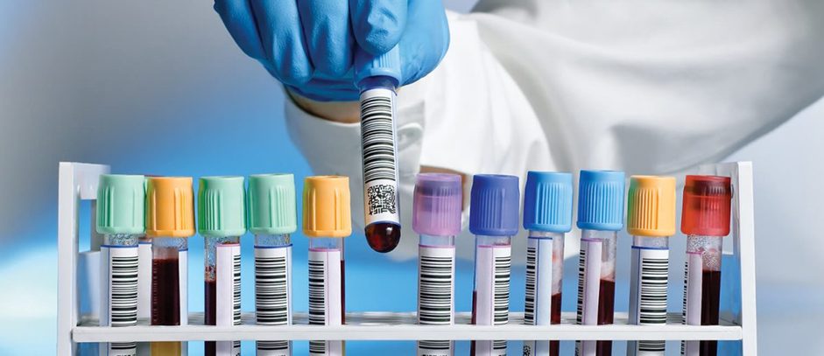
What do we learn ?
Basics and application of
Biochemistry
Microbiology
Virology
Mycology
Parasitology
Clinical Pathology
Hematology
and Blood transfusion techniques

Slide 16
Major Areas of Training
Different laboratory test relevant to procedure and findings/results.
Practice appropriate bio-safety measures in the laboratory.
Perform correct procedure for collection of various specimens.
Store, transport, preserve and process the specimen properly.
Handle laboratory instruments.
Describe the standard operative procedure of instruments.
Interpret different laboratory reports with accuracy.
Maintain internal & external quality control.
Discard biomedical waste as per set protocols.
Effectively communicate with the patient.
Medical Ethics relevant to the situation.

Slide 17
Certification
“BSc Lab Sciences”
Employment
Hospitals
Imaging Centres
Private Clinics
Government jobs

Slide 18
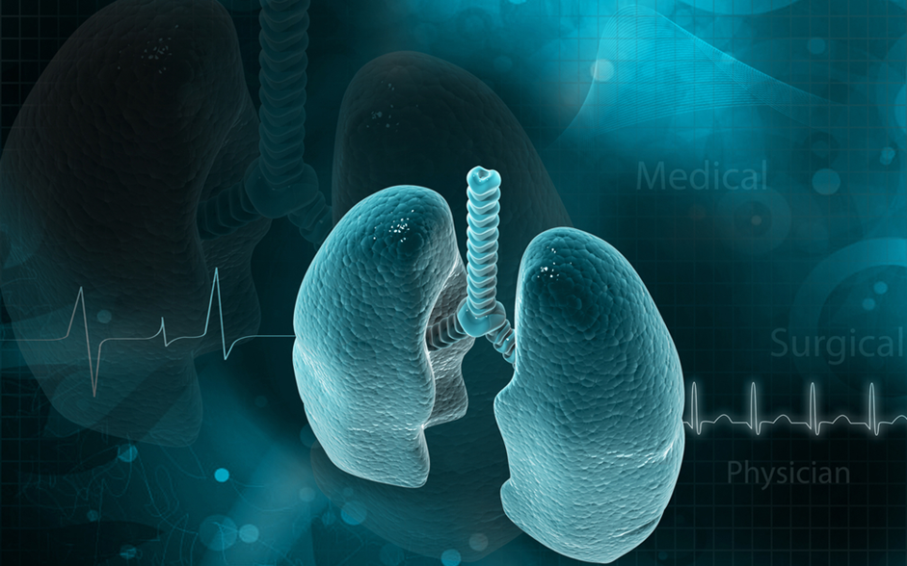
BSc Respiratory Care Technology (Respiratory Therapy)
Respiratory Therapy is devoted to the scientific application of technology in order to assist in the diagnosis, treatment, management and care of patients with cardiopulmonary and associated diseases.
To be precise, it deals with cardiopulmonary problems. The respiratory system is prone to diseases and conditions such as – trauma, bronchitis, asthma, pneumonia etc

Slide 19
What do we learn?
Basic Sciences including Anatomy and functions of respiratory and cardiovascular systems.
Clinical aspects of respiratory diseases and the need and rationale for Oxygen therapy.
Introduction to assisted Ventilation and Airway management in various conditions and ages.

Slide 20
Uses of Respiratory Care Technology (Respiratory Therapy)
Respiratory therapists help people who suffer from chronic respiratory diseases like asthma, bronchitis and emphysema. ... They also provide emergency care to patients suffering from heart attacks, drowning or shock.
This would involve managing patients on ventilators and artificial airway devices, and assessing the blood-oxygen level of patients. Just a few of the responsibilities of respiratory therapists include: Managing life support mechanical ventilation systems. Administering aerosol-based medications.

Slide 21
Major Areas of Training
Assessment of respiratory and cardiovascular system
Symptomatology and signs of Respiratory diseases
Rationale for Oxygen therapy
Assessment of need and adequacy and therapy and the relevant devices
Nebulizers and metered dose inhalers
Gas analyzers
Manual resuscitators
Artificial airway
Mechanical ventilation principles and pharmacotherapy
Advanced Respiratory care including neonatal ventilation

Slide 22
Certification
“BSc Respiratory Care Technology”
(Respiratory Therapy)
Employment
Hospitals
Imaging Centres
Private Clinics
Government jobs

Slide 23
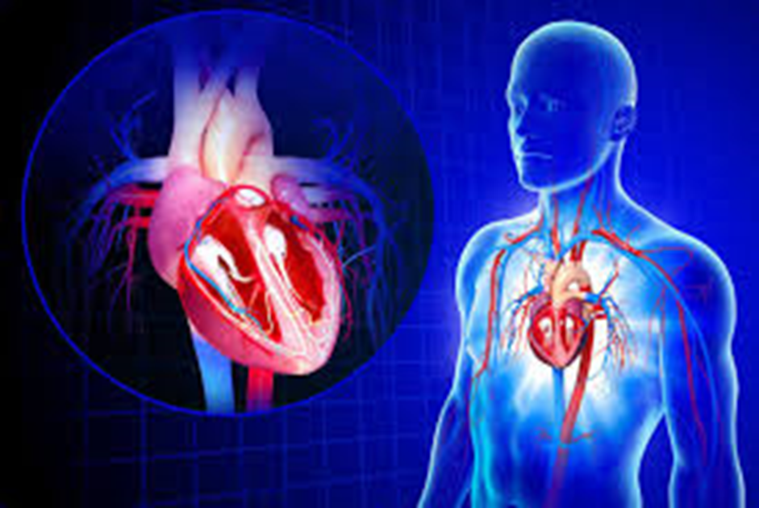
BSc (Cardiovascular Technology)
Cardiac Technologists assist physicians in: diagnosing and treating cardiac (heart) and peripheral vascular (blood vessel) conditions. ...
Management of various cardiac disorders having complex diagnostic and therapeutic procedures

Slide 24
What do we learn?
Basic Sciences including Anatomy and functions of cardiovascular systems.
Clinical aspects of cardiac diseases and the need and rationale for cardiac related therapies.
Introduction to assisted Ventilation and cardiac management in various conditions and ages.

Slide 25
Uses of Cardiovascular Technology
A cardiovascular technologist use medical imaging methods like ultrasounds to diagnose heart conditions, vascular problems, or ailments that involves the heart, it's arteries, valves, or blood vessels.
Cardiovascular technologists and cardiovascular technicians serve as cardiovascular assistants to physicians.
They aid in the diagnosis and treatment of heart and blood vessel issues. Their day-to-day tasks include reviewing doctor and patient documentation, scheduling appointments and monitoring patients' heart rates.

Slide 26
Major Areas of Training
Assessment of cardiovascular system
Symptomatology and signs of cardiac diseases
Rationale for Oxygen therapy
Assessment of need and adequacy and therapy and the relevant devices
Gas analyzers
Advanced cardiac care including neonatal ventilation

Slide 27
Certification
“BSc Cardiovascular Technology”
Employment
Hospitals
Cardiac Cath Labs
Private Clinics
Government jobs

Slide 28
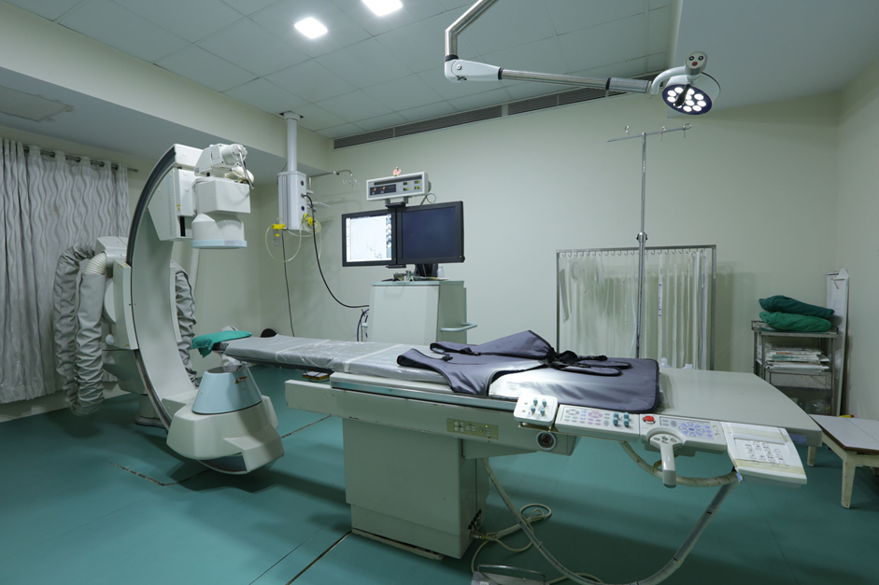
BSc (Neuro Electrophysiology Technology)
Neuro Electrophysiology course enables the neuro technologists to perform and interpret electrophysiology procedures.
It enables students to assess the patient and plan various electro-diagnostic procedures and implement them. ...
The student will be able to achieve technical skills needed to conduct various diagnostic procedures

Slide 29
What do we learn?
Basic Sciences including Anatomy and functions of Nervous systems.
Clinical aspects of nervous system related diseases and the need and rationale for nervous system related therapies.
Introduction to management in various conditions related to nervous system.

Slide 30
Major Areas of Training
Sleep studies
Autonomic function tests
Pre-surgical evaluation of epilepsy
EEG (including Neonatal and long term monitoring)
Nerve conduction studies, Electromyogram, Visual evoked potential, Brainstem auditory evoked potential, Somatosensory evoked potential

Slide 31
Certification
“BSc Neuro Electrophysiology Technology”
Employment
Hospitals
Neural Labs
Private Clinics
Government jobs

Slide 32
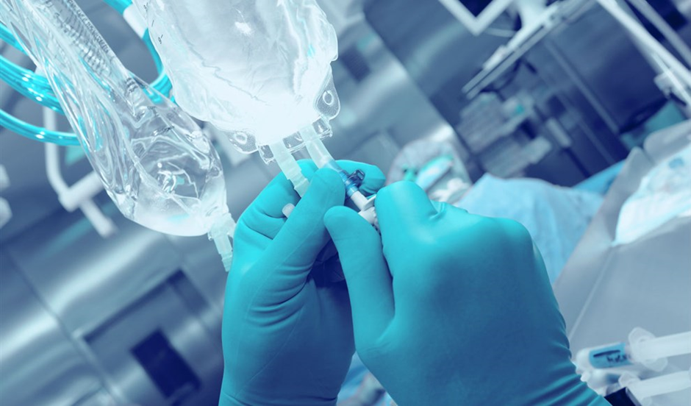
BSc (Anesthesia & OT Technology)
They are responsible for direct and indirect patient care, equipment set up and operation procedures.
They are trained to assist the surgeons during the procedures and assume responsibility for completion of other functions as assigned.
Learn about anesthesia equipment, anesthesia agents, techniques as well as dosage in order to ensure a better monitoring of the patient.
The knowledge gained by the students through B.Sc. in Anesthesia Technology helps them in choosing the right anesthetic treatment for a patient and its dosage.

Slide 33
What do we learn:
Prepare and maintain operation theatre Maintain equipment support in an emergency situation.
Follow infection control policies and procedures Maintenance of theatre equipment's
Provide intra-operative equipment and technical support
Manage hazardous waste
Ensure availability of medical and diagnostic supplies
Maintain a safe, healthy, and secure working
Follow radiation safety guidelines
Follow biomedical waste disposal protocols
Record keeping

Slide 34
Uses of Anesthesia & Operation Theatre Technology
Anesthesia and OT technology is a job oriented course and their main task is to assist Doctors/Surgeons during surgery, by administering appropriate dose of anesthesia and operating anesthesia equipment whenever required.
The Operation Theater and Anesthesia Technologist are responsible for direct and indirect patient care, equipment set up and operation procedures. They are trained to assist the surgeons during the procedures and assume responsibility for completion of other functions as assigned.
A modern Operation Theatre is a cornucopia of various state of the art machines & equipment's. The set up, preparation and handling of these equipment then becomes a vital part of the functioning. ... Operation theatre technology is meant to train the candidate in all the procedures in operation theatre.

Slide 35
Major Areas of Training
IV fluids and Transfusion related matters
Dressing, sutures, bandages and plasters
Recovery room and nursing care
Pre-Operative and Post-Operative
Management of Patients
Patient handling and Transportation to and from the Operation theatre
Universal precautions for HIV Positives, HBsAg Positive
Introduction to Operating room
Discipline, Lay out, Equipment’s, Lights,
OT table, suction, scrub station
Electrical Devices – Electro cattery, Laser, Harmonic, Ligature
Power Surgical Instruments – Drills Saw, Reamer
Sterilization assembly and packing
Principles of Sterile Techniques – Surgical scrub, gowning and gloving
Surgical instrumentation, handling instruments

Slide 36
Certification
“BSc Anaesthesia and OT Technology”
Employment
Hospitals
Cardiac Cath Labs
Super speciality Hospitals
Private Clinics
Government jobs

Slide 37
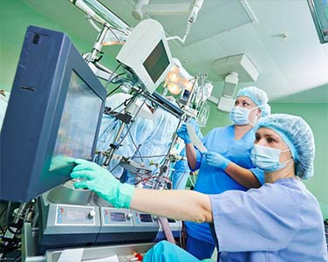
Cardiovascular perfusion is the science of providing extracorporeal circulation in order to artificially support and temporarily replace a patient’s respiratory and circulatory systems.
A perfusionist is a skilled allied health professional, trained and educated specifically as a member of an open-heart surgical team, responsible for the selection, setup and operation of a Heart-Lung Machine and other life support system like IABP, LVAD, RVAD & ECMO.
It will help in overall development of technical and interpersonal skills required to work under the supervision of Cardiologists, CTVS surgeons and Anaesthetists.
BSc (Perfusion Technology)

Slide 38
Scope
Perfusion technology has a wide range of applications since it is an essential job function that cannot be easily replaced. A perfusionist is required by every surgical team to control the technical elements of the medical equipment so that the physicians and nurses may concentrate on their duties.
After finishing a B.Sc. in perfusion technology, students might pursue further studies in the field. Candidates with a master’s degree and speciality will have a greater chance of landing a job and will have an advantage over the competition. These perfusionists and technicians are in charge of the surgery’s heart and lungs apparatus and equipment.
You can also pursue an MSc in Cardiac Perfusion Technology, which can open up numerous doors for you in the future.
These technicians and perfusionists run the surgical machinery for the heart and lungs. Additionally, they control blood vessel conditions.

Slide 39
Certification
“BSc Perfusion Technology”
Employment
Hospitals
Super speciality Hospitals
Private Clinics
Companies
Government jobs

Slide 40
Clinical Research is an academic degree in clinical research. It prepares graduates for positions in pharmaceutical, biotechnology, and biomedical research. A degree in this field is highly sought after in the medical field, and is a key element of a successful career.
Clinical research is a branch of healthcare science that explores how safe and effective novel treatments, medications, medical devices and diagnostic techniques are when administered to patients.
BSc (Clinical Research)

Slide 41
Scope
BSc clinical research is offering a very high remuneration to the professionals. A bachelor’s degree in clinical research that consumes 4 years time is awarded to the ones who completed the relevant educational needs for the specific academic programs.
By attaining a bachelor’s degree, student may get highly qualified and get better job opportunities.
The academic program, BSc Clinical Research include the classes that encompass organic, general, biology, microbiology, advanced chemistry, physiology and human anatomy. As per the latest survey conducted, there are around 1 lac job openings and even more. The figure seems to be countless and thus the field appears to be most promising.

Slide 42
Certification
BSc Clinical Research”
Employment
Hospitals where Clinical Trials are conducted
Super speciality Hospitals with Clinical Trials
Companies
Government jobs
As Clinical Research Officer in Hospitals/ Ethics Committee

Slide 43
Course Structure
Sr. No | Course Name | Duration
1. | BSc. Courses | 4 years (3 Years divided in to 6 Semesters + 1 Year Internship)
2. | PG Diploma Courses | 1 year
3. | Certificate Courses | 1 year

Slide 44
Syllabus
Common during I & II semesters for all B.Sc Paramedical courses. The subjects include Anatomy, Physiology, Microbiology, Pathology, Biochemistry, Pharmacology, Community medicine, English and Communication Skill, Principles Of Nursing, Computer related to medical care.
The syllabus for III to VI semesters will be covered by the department concerned.
ON THE JOB Training will be imparted in the curriculum

Slide 45
Method Of Selection
Interview by a board of faculty members

Slide 46
Time Line of Courses for AY 2023-24
1 | Start of Registration | 05 June 2023
2 | Interview call letters | 12 Jul 2023
3 | Conduct of Interviews | 20 to 24 July 23.
4 | Result of Interview | 26 July 2023.
5 | Last date for fees | 31 July 2023.
6 | Courses start on | 01 Aug 2023.

Slide 47
Thank You

